Slide 1
Welcome

Slide 2
Index
Quick Introduction About Project.
Aim Of This Project.
Some Graphs About This Project.
Summary.
Reference.
End Of The PPT.

Slide 3

Introduction Of the Project
What Is loan?

Slide 4
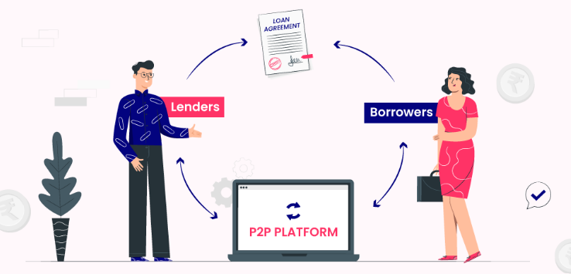
P2P loan

Slide 5
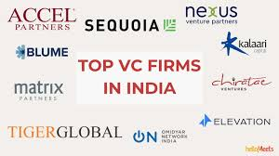
Some Private sectors For Loan

Slide 6
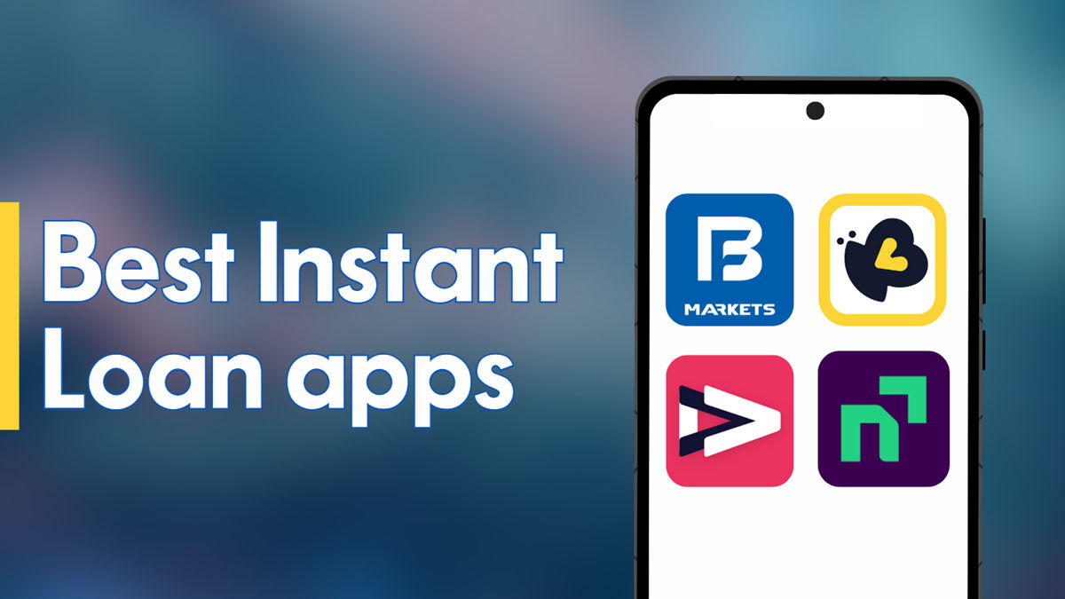
Online Application For Loan

Slide 7
Aim Of This Project
If you are Working As Data Scientist In any Financial Company,
Then how you will manage the Data of That Financial Company
Then This Project Will Help You to Find Your Way
This The Main Aim of This Project

Slide 8
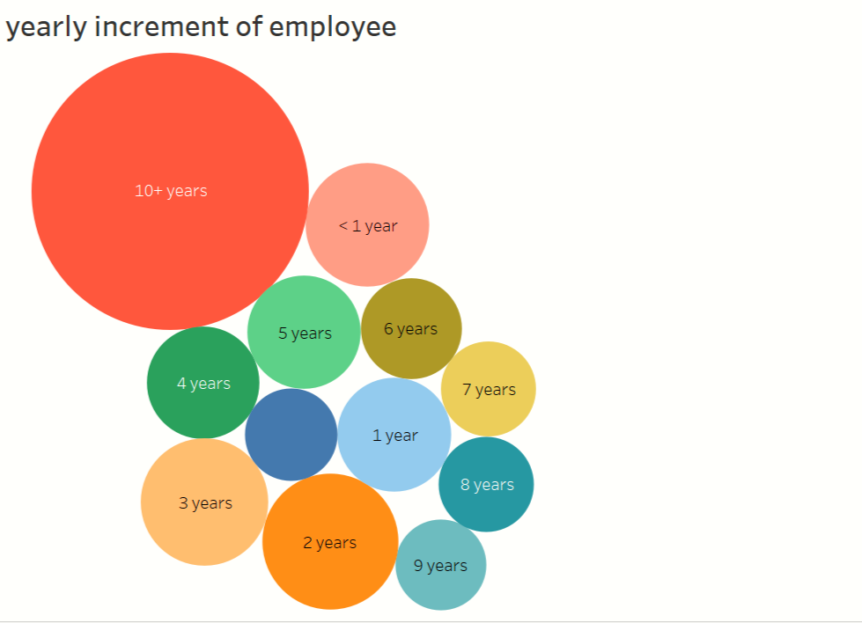
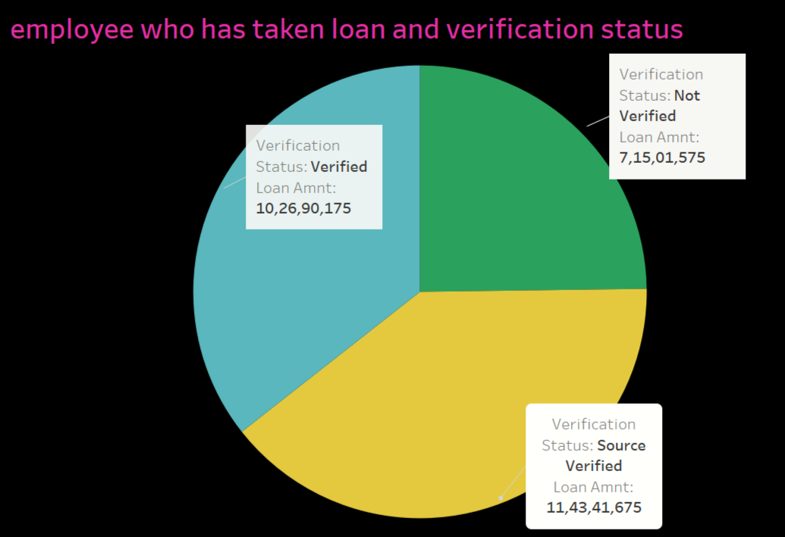
Some Graphs Will Help US

Slide 9
Summary
From This PPT You Can Take Basic Information How To Manage The Data
How To Work AS Data Scientist For Any Financial Company.
How To Identify The Data Of That Company.
Main Aim of This Project Is To Make Our Life Easy.
And Making Loan Method Easy To Use.
We Can Analysis This Things With Help Of Some Small Coding Methods
Some Small Application Making.
To Analysis This Loan Methods.

Slide 10
Reference For More Information
WWW.google.com
You Can Get More Information Of this Project Form My GitHub Account The link is Given Below
https://github.com/shifa-shaikh-2002/loan-project/blob/f73648661537b30c266ffcf602c5cf7098dcbb82/README.md

Slide 11
Thanking you

